Slide 1

PORTFOLIO SITE

Slide 2
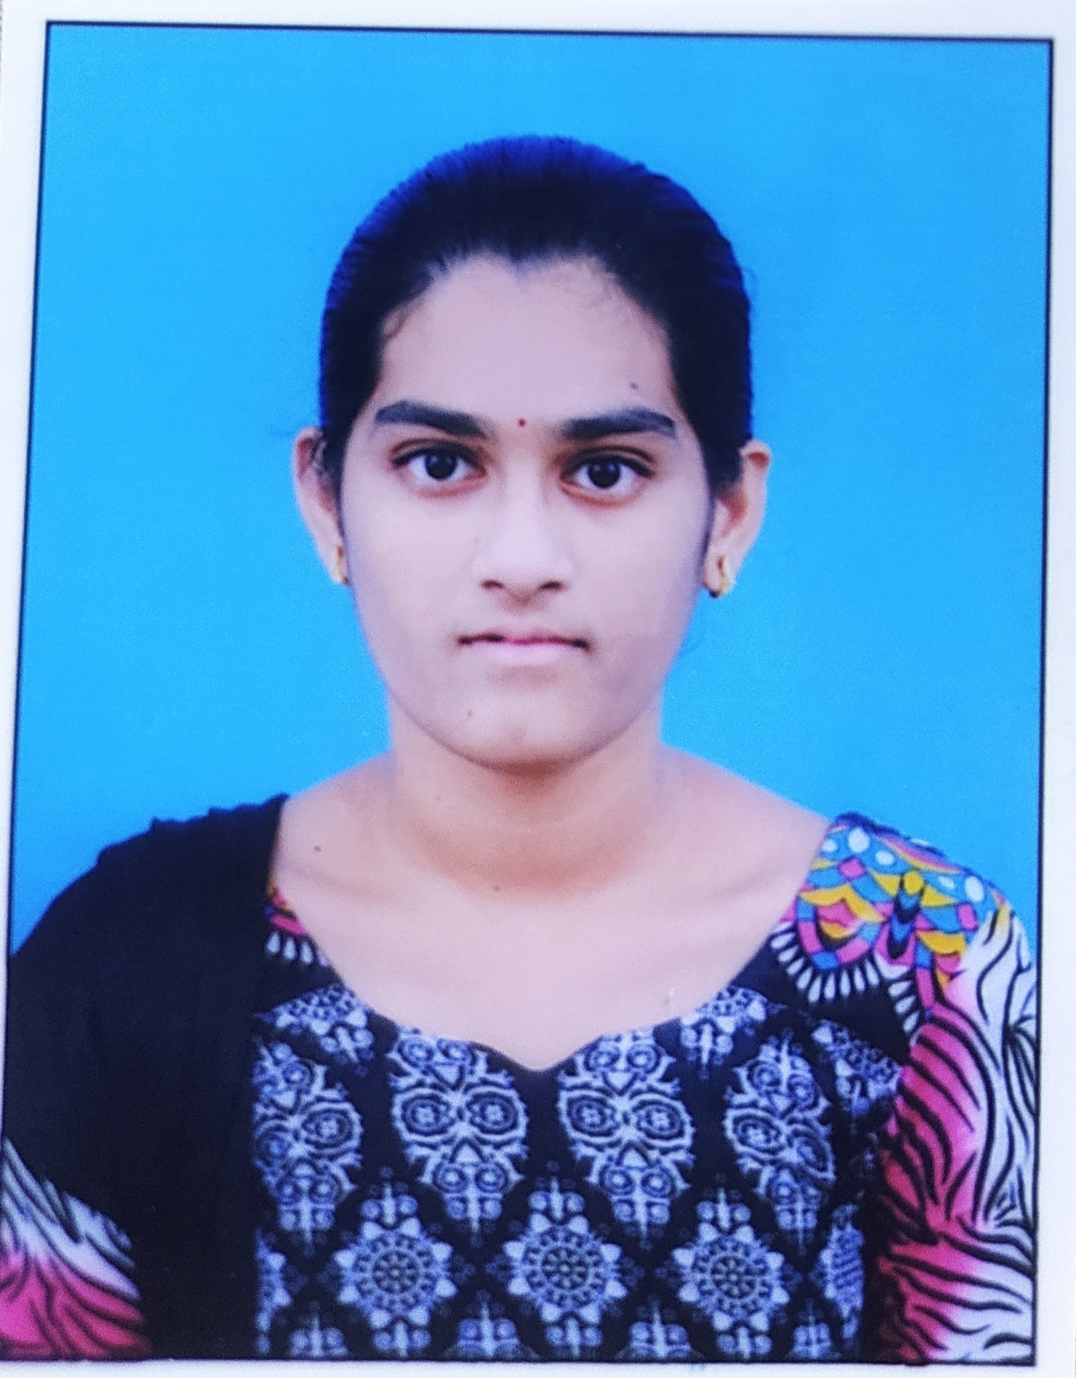
STUDENT DETAILS
NAME : MUTHULURU SNEHA SAI
SkillsBuild Email ID: snehasai148@gmail.com
College Name: JNTUA College of Engineering Anantapur
College State: Andhra Pradesh
Internship Domain: Front End Development
Internship Start and End Date: 5th June 2023 and 23rd July 2023

Slide 3
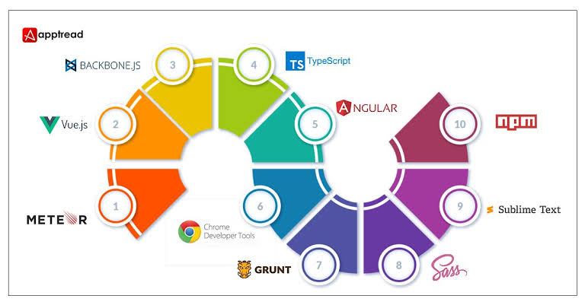
PROJECT TOPIC
A portfolio website is a unique way to showcase your work and let others know about yourself.
It’s like an evergreen platform for your projects,case studies, and information about you.
In addition, it’s one of the best ways to express your personality, experience, and capabilities.
The striking portfolio websites in this selection demonstrate a unique approach to web design and plenty of personality.

Slide 4
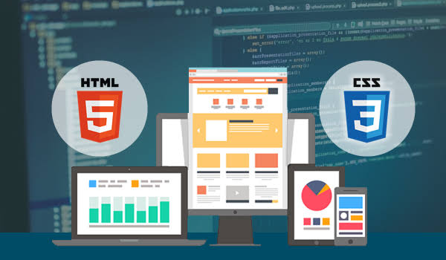
AGENDA
The Portfolio Website project is based on Web Development.
This is developed using HTML5,CSS and JS. Code Editor used for this project is VS Code. It displays the professional background of an individual.
It displays brief information about work experiences till date, education, skills and contact details along with social media links. All the elements are rendered distinctively on the website.
This project describing the process of portfolio website simply by defining and explaining the main terms and methods used for web design and development.

Slide 5

PROJECT OVERVIEW
The objective is to find a web design and front-end developer job by creating a portfolio.
The goal was to create a website to promote design work and show professional skills of adesigner and developer in best possible way.
The portfolio needs to be unique and memorable. Responsive design also needs to be implemented.
The purpose of the project as well as describing what problem needs to solve, also have to be included into the brief.
The process of creating online portfolio can be divided to three main stages,such as project planning, designing and development.

Slide 6

Who are the End Users
The personal information that you incorporate into your portfolio can greatly reflect on your abilities as an individual as well as become a useful tool in marketing yourself to employers, corporations, colleges and universities.
It helps organisations determine which projects,programs, and work items should be continued, should be started, or should be stopped.
Portfolio website is also meant to give site visitors general information about the owner of the site.

Slide 7
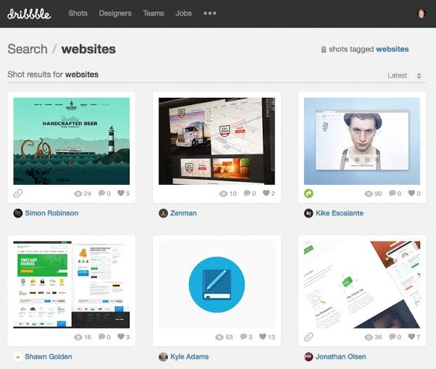
Solution and its Value Proposition
A professional portfolio is an excellent way to present the work to potential employers and display the skills that qualify for a position.
While not every employer and position requires a portfolio, a strong demonstration of work can help distinguish from other candidates on industry.
A portfolio website provides a central location where potential employers can view the work in one place and get get know about you better.
One can impress their hiring manager by bringing a well-articulated and polished portfolio to an interview.

Slide 8

UNIQUE ASPECTS
Design
Logo with Tagline
Call to Action
High Quality Images
Testimonials
Contact Information
Information about yourself
Relevant Social Media Accounts
Relevant Personal Projects

Slide 9
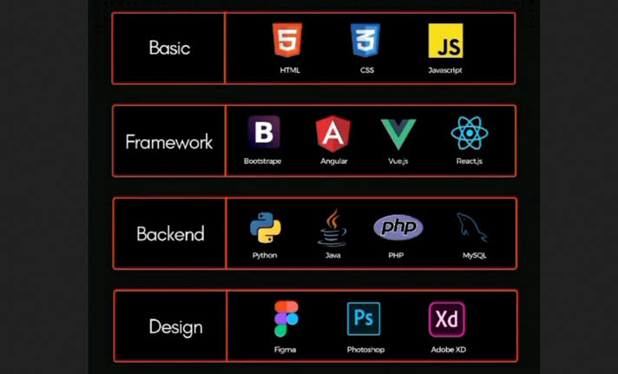
MODELLING
There are three key criteria to take into consideration when asserting a portfolio: the combined value of the projects in the portfolio, the overall risk/value balance, and the alignment of the portfolio with the strategic goals of your business.
Basic HTML and CSS ,but want a more consistent UI, you may want to check out a CSS framework. CSS frameworks make it easier , and quicker, to style elememts.
A portfolio framework sets out how the portfolio is managed. This is also known as a: Centre of Exellence, Project Lifecycle, Project Standards.

Slide 10

RESULTS
A portfolio is aliving and changing collection of records that reflect your accomplishments, skills, experiences, and attributes. It highlights and showcases samples of some of your best work, along with life experiences, values and achievements.

Slide 11

LINKS
http://www.smashingmagazine.com/2011/01/guidelines-for-responsive-web-design/
http://en.Wikipedia.org/wiki/Grid
http://cyberchimps.com/parallax-web-design/
GIT HUB LINK
https://github.com/MuthuluruSnehaSai/PORTFOLIO.git
WEB PAGE LINK
file:///C:/Users/SNEHA/OneDrive/Desktop/PORTFOLIO%20SITE/index.html

Slide 12
THANK YOU

